Slide 1

Steering Committee Meeting
August 17, 2016
WebEx Meeting Recording
https://financialpartners.webex.com/financialpartners/ldr.php?RCID=42c4c38eaa46a066901077171ddc9a79
Collateral Web Q4 Enhancements - Steering Committee Meeting Wednesday, August 17, 2016 2:10 pm | Eastern Daylight Time (New York, GMT-04:00)

Slide 2
Steering Committee Members
Association | Member | Present? Y/N/Rep
FPI | Bevin Morrissey Aaron Clayton Rebecca McFarland Bob Hoffman Charles Branche Scott Rackliffe Dan Welch Jeff Marshall Jason Hilzendeger LeeAnne Nikolao Dan Sanders | Y Y Y Y Y N N N Y N Y
AgCountry | Kari Seidel Becky Thibert | Y Y
Farm Credit East | Steve Rickenbacher Ryan Hrobuchak | Y Y
Farm Credit West | Melissa Gomes | Y
Northwest | Jacob Ruland | Y
Yankee | Kyle Lussier | Y

Slide 3
Agenda
Greetings and Intro
Defined Items
Undefined Items
Notes:
Collateral Web Enhancements Team
Bevin Morrissey – Project Manager/BA
Bob Hoffman – Project Sponsor and Architecture/Design SME
Rebecca McFarland – Lead Developer
Aaron Clayton and Kevin Geissler – Business Analysts
April Beston – Quality Assurance Analyst
This team is ONLY working on enhancements; we will not be working on bugs/defects.

Slide 4
Defined Items
FEMA Hyperlink for flood maps on Buildings Panel
2017 IRS Requirements for Real Estate Collateral
Fix the Lien Position / Loan Position
Calc Change for Participation Loans Secured by Chattel

Slide 5
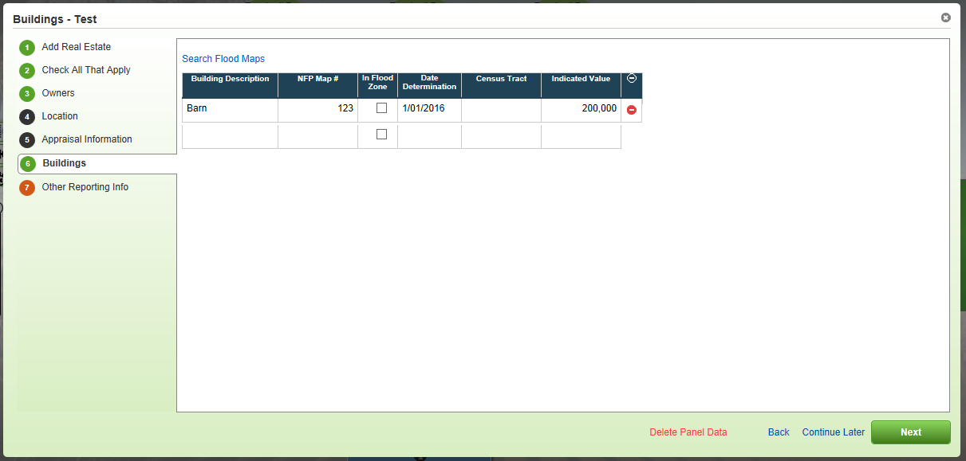
FEMA Hyperlink for Flood Maps
Notes:
Added a hyperlink to search Flood Maps on Buildings panel.

Slide 6
2017 IRS Requirements for Real Estate Collateral
For Tax Year 2016, IRS is requiring the collection of certain pieces of data:
(Box 7) Address of Property Securing Mortgage
(Box 8) Property Address (If Different form Payers’s/Borrower’s Address)
(Box 9) Property Description (If No Address Available), e.g.
Jackson County, MO
AA-BBB-CC-DD-EE-F-GG-HHH
Notes:
Applies to Real Estate wizard.

Slide 7
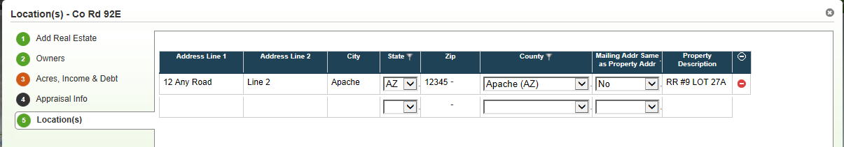
2017 IRS Requirements for Real Estate Collateral
Proposed Enhancement
Add fields to Locations panel for Real Estate:
“Mailing Addr Same as Property Addr”
Drop down for Yes/No
Will be required
Property Description
Will configure ON Address fields for all ACAs
If different mailing address, either address fields OR Property Description is required
Notes:
FCW: Consumer or all loans?
Requirement for 1098; will show up on 1098.
AgC: Property Description field - how is that different than the Collateral Description used today?
Not all ACA’s use Collateral Description for address.
Property Description is for when property does not have actual address.
FCE: What about loans with multiple addresses/properties… what address will get put on 1098? All addresses?
1098 for each loan? Or total interest paid to have Mortgage interest?
FPI: Believe it is a customer level report with multiple line items on it.
FPI will look into more and get back to group -> FPI ACTION ITEM
Dan Welch has been working on this; IRS will be issuing clarifications on these types of things; AgC waiting on clarification to determine how they will comply.
Requirements were initially written for residential property.
FCW: Will there be any soft errors associated with these new fields if users do not fill them out?
If the property address and the residential address are NOT the same, you will need an address for the property or a property description. This is a hard error – one or the other is absolutely required.
FCE concerned about not meeting IRS requirement.
Guidance has been requested as how to handle for farm real estate where there are multiple sections.
FCW would like more information regarding IRS request specific details/background information.
Fine adding to Collateral Web but will need to explain why.
Have each ACA been given representation on this?
FPI to follow up with Dan Welch & Dan Hagan and then get back to Steering Committee -> FPI ACTION ITEM
Need to comply, therefore need to get fix in for November patch so that is available to fill out so that feeds into 1098 extract for 2016 tax season.
FCE: Will we need to do major data scrub in order to get this in by year end for everyone do a 1098 for?
Yes, for anyone who meets the requirements.
FCE: Should this change be made in Collateral Web or in EmPOWER to get pulled into 1098? Customer level issue or collateral issue with every property they have?
If at collateral level, have to keep in Collateral Web.
FPI to find out and follow up with Steering Committee -> FPI ACTION ITEM

Slide 8
Make Lien Position Configurable
Issue Reported
Request from FCE
Wanted to turn off Lien Position
Proposed Enhancement
Provide the ability to configure (at the association level) Lien Position ON or OFF
ON will be the default setting unless otherwise indicated
Notes:
Configuration item only.
AgC: ON
YNK: OFF
FCE: OFF
FCW: ON
NW: ON

Slide 9
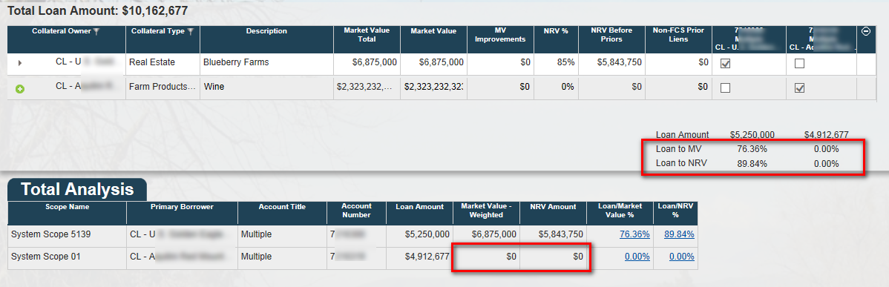
Purchased Participations Secured by Chattel
Issue Reported
Currently, if you have a participation loan secured by chattel, the MV and NRV of the chattel are not reflected in the Collateral Analysis screen:
Proposed Enhancement
The system should perform a behind-the-scenes check on LT loans.
If they are participation loans, rather than regular LT loans, then chattel will be allowed as a valid collateral type for securing the loan.
Notes:
For Long Term Loans, FCA regulates can only use Real Estate collateral, not Personal Property collateral.
For Participation loans, FCE codes as long term in system even though short term in reality.
AgC: same as when purchase participation on a short term loan from someone in farm credit system, AgC books to FLCA.
Wouldn’t call long term, but will book to FLCA.
ACA (FCE for example) would book to long term commitment type; don’t have FLCA, which is why need different rule for participation purchased.

Slide 10
Edit Loan Position on Collateral Analysis
Issue Reported
Request from FCE
Ability to set Loan Position on the Collateral Analysis screen
Proposed Enhancement
When Lien Position is configured OFF, then Loan Position can be manually edited on the Collateral Analysis screen.
If Lien Position is configured ON, Loan Position will continue to be locked down on the Collateral Analysis screen.
Notes:
This enhancement is in conjunction with making Lien Position configurable.
No change for those ACA’s leaving Lien Position configured ON (see slide 8).

Slide 11
Undefined Items
Provide a way to ensure that any newly calculated LTV ratios based on loan balance changes always get to LOS along with the recalculated LGD
Multiple Scenarios for same system scopes causing issues

Slide 12
Updated LTV/LGD to LOS
Issues Reported
NW: Refresh Button on Existing Loans
Add a refresh button on existing loans in Collateral Web to allow the program to recalculate the LTV ratio and LGD.
Currently, users have to trick the system to trigger a recalc. Users need to change something in a scenario, close and reopen the scenario, then revert whatever was changed to its original state.
AgC: Updated L/V and LGD not flowing to EmPOWER
Updated L/V and LGD do not flow to EmPOWER if the loan amount or other fields that affect collateral values do not change in CW.
Data must be “dirtied” in CW by modifying collateral amounts, etc. to trick the system into updating values so they can be resubmitted to EmPOWER.
Encounter the issue both on actions that require CW (loan origination) and actions that have no collateral impact (reamortization). In both cases, need accurate L/V and LGD.

Slide 13
Updated LTV/LGD to LOS
Stated business need:
Data integrity, internal and external audit issue.
PWC did a deep dive into LGD’s a few years ago, and multiple processes were put in place to monitor LGD’s for accuracy.
Forcing a user to put in “fake values” to trigger an update creates a significant data integrity issue.

Slide 14
What are we trying to solve?
Does LTV/LGD need to update for all loans in the scope when making a minor update (e.g. text change) in Collateral?
Does LTV/LGD need to update for all loans for the customer when working on one loan?
Do we need a way to force LTV/LGD to update in LOS because of amortization?
What is audit committee expecting to see that they are not?
Anything else?
Notes:
NOTES FROM DISCUSSION
AgC: preference is that any time touch something in collateral web, that LTV and LGD would update.
AgC does not tie chattel LGD’s to LTV’s at all – those are assigned.
Are only ACA that does not have grid for assigning chattel loan LGD.
On real estate side, on old system, would have this updating, so staff now expect this to update real-time on LGD side.
Every opportunity to force new LGD they would take.
FCE only change LGD when actually booking an action.
AgC would propose changing LGD as payments are made, but that is not possible.
Based on what have today, when book an action would like LGD to update, if have done something in Collateral, even if did not touch any values.
Would still want the ability to change something to the Security doc, and not have that push values to new action submit.
Don’t want to lose new action submit piece.
FCW: If this situation occurred, would there be a trail to know values changing in Collateral and there will be an action, but it won’t be a new action submit, would be like a Collateral auto-book.
Could say for a given date, something was done in Collateral Web that triggered an LTV/LGD change so that in EmPOWER you can see there was an action which caused values to change.
FPI: Correct, would not be like a new action submit. If calculations change, there will be a Credit Action associated with it.
FCW: If change actual Collateral icon, would be nice to see that change go through and update LTV/LGD.
FPI confusion:
Currently, just change label, nothing happens with LTV/LGD.
AgC is saying they would like LGD & LTV to recalculate and get into EmPOWER because something was changed in Collateral.
No financial/monetary data has changed, but would still like this to update EmPOWER.

Slide 15
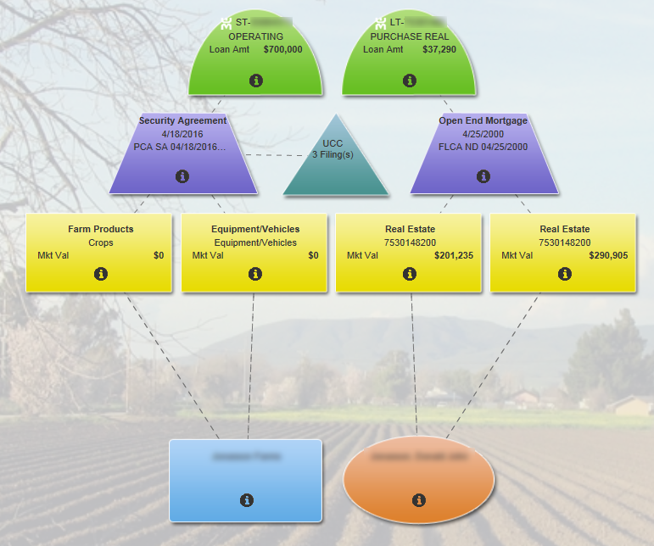
Example – 2 scopes, 2 loans
What do we expect here?
Notes:
Is everyone on same page? If making non-monetary change in Collateral, would every ACA like LGD/LTV to flow into EmPOWER?
If so, what scope would go into EmPOWER?
See above: left side have loan 1, right side have loan 2.
Loan 1 is tied to two pieces of collateral
Loan 2 is tied to two different pieces of collateral
Say you update address for piece of real estate on loan 2, no ratios or anything being impacted.
Say have paid down the loan at the top, and have two payments since last time were in Collateral
What would you expect to see going into EmPOWER?
Updated LTV and LGD for Loan 2, because touched something related to it?
Or expecting to see Loan 1 also, because same customer?
AgC: expecting for loans involved in that scope, wouldn’t touch any loan associated with that customer.
If touching Collateral for loan 2, would expect just loans associated in that scope would be adjusted.
FCE: What does synchronization action do today?
If make change in a loan scope, doesn’t that force updated LGD into EmPOWER as of today?
FPI: If change something which affects calculation, then yes.
Issue is changing something that does not affect calculations.
FCE: Why would LGD change if not changing values? Because the loan amount changes since last time in?
FPI: Correct, as amortization occurs, loan value will be different over time, so theoretically LGD will be different.
FCE: For reporting purposes, only important quarterly? Can it do mass updates quarterly across all loans?
FCW: Has to “dirty the screen” to force update to get overall LGD updates for all loans for a customer.
Example: working on short term loan, LTV does not automatically update for long term loans in portfolio, so need to dirty the screen to get updated LGD.
Collateral Web does not talk with EmPOWER automatically.
AgC runs into same scenario.
AgC: Manual refresh button?
FPI: different ways for credit action to get into EmPOWER
Autobook function?
AgC has had problems with autobook.
FPI: Calculating behind the scenes/refresh button would be about same size scope and functionality wise.
FCE: Does refresh button apply to every loan in every scope for a customer?
FCE not having same issue as other ACA’s because 95% of time, if touching one loan, and everything is cross collateralized, it updates everything at once. Once book action, an automatic action happens which is sent for other loans they are not doing an action for. But because touch collateral, LGD gets updated on other loans as well.
Other ACA’s don’t often have cross collateralization, so when editing short term loans, long terms loans don’t get updated.
As a result, would then want updated LGD for every loan in every scope possible for a customer?
AgC: Will do short term right after long term, but don’t cross collateralize them all equally.
FCE: Don’t need to be crossed equally, but they share collateral, so if change something in one (short term loan for example) then the long term loan LGD gets updated as well, then an action occurs which sends action to long term loan to update LGD.
While most long term loans also have short term loans, there are a whole group of loans being missed if no short term relationship being updated. Wouldn’t it make more sense for the entire system if bulk updates happened periodically? That way, all LGD’s get updated.
Current proposal would catch some changes, but not all.
AgC: Used to do quarterly update of LGD, but did not get far with project.
Would be open to this bulk update.
FCW: ability for bulk update (quarterly) has been desired for awhile.
YNK would also like quarterly update.
FCE: in order to happen, every loan in system must be properly linked, and if some have LGD override from calculation, override would still need to stand, and have those loans not do recalc.
AgC currently has this process.
FCW mainly override operating loans only, so would prefer to focus on long term loans.
FPI to do more research and get back to Steering Committee within two weeks -> FPI ACTION ITEM
Could be very large in size to accomplish this.
How solve for this may impact what can be done for multiple scenario situations.
May need to table this conversation as more research is done.

Slide 16
Multiple Scenarios for Same System Scopes
Issues Reported
AgC: Objects “owned” by a scenario not visible to other scenarios
Some situations require multiple scenarios for the same customer (branch is working PCA loans while Lending Operations is working on FLCA loans; loans may be booked at different times and be at different stages).
User is unable to see which objects are “owned” by which scenario; if they inadvertently make a change in an object “owned” by another scenario, CW locks up, FPI has to script out the scenario and we start over.
FCE: Goal is to reduce the number of multiple collateral scenarios.
It is probably infrequent that staff would want to create multiple scenarios for the same group of loans. Would like a warning if possible.
Notes:
See prior slide for scope/scenario discussion.
This issue will be impacted by decision on prior issue for LTV/LGD, what can and cannot do.

Slide 17
Scenarios/system scopes
Possible solutions
Option 1:
Don’t allow multiple scenarios to be created per scope, but also don’t lock at the scenario level. Instead, lock at the system scope level so multiple users can work on the same customer at same time, just not on the same system scope.
Notes:
NOTES FROM DISCUSSION
(Reference slide 15 with screenshot of Collateral Web):
Screenshot could be one scenario; could have two separate people working on same customer, but person 1 could only work on the operating loan, while person two could only work on the long term loan.
FCW: staff have gotten used to this, no longer an issue for them; have learned how to work around.
Hesitant on option 1; staff do not focus at the scope level, usually in a scenario focusing on the entire view.
FCE: Multiple scenarios is #1 issue in Collateral Web.
Not so much locking between scopes; when have two different actions going and only 1 can “win”, then lose all the other work they had done before.
Exacerbated for FCE because most loans are cross collateralized.
Lead to situation where have two scenarios for loans in the same scope.
Don’t want to allow Multiple Scenarios in the same scope to happen anymore.
If start a scenario with one scope, and then bring in another scope, fine with that, as long as in same scope.
Just don’t allow (for either scope) to start another scenario.
Ability to start two scenarios where can only book one of them should not be able to happen.
Only want “one source of the truth”, preventing scenarios being created that can never be booked.
AgC: is this talking about once it has been submitted?
Modeling ability exists to create multiple scenarios which could fall into same scope to see alternatives.
FCE does not model, causes issues, people create all these scopes not realizing only one of those scenarios can be booked, causing them to lose data in another scenario.
AgC: once a scenario is applied, then should not be able to create more scenarios touching that scope.
Agreement; issues where once apply information, users can somehow create another scenario with that same scope, and when they try applying, user has no idea that that information has already been submitted in another scenario; the object was not visible.
When trying to apply, currently there is nothing validating that the information was already submitted for another scope, causing users to lose information.
Bottom line - once scenario is applied, then it should be locked down.
FCW: had same situation, but launching in from Security Docs screen currently has message telling users about another scenario.
AgC: timing issue – not always being launched from within EmPOWER, so don't get message.
Have trained staff to look and check for other scenarios.
AgC has branch staff start some things but still need to continue to work in same customer (and potentially other scenarios) while also having centralized groups overlapping and doing some work in same customer.
Ran into issues, could not keep communication channel clear, and user could not see what implications were.

Slide 18
Scenarios/system scopes
Option 2:
Start a new scenario, the app will ask you which scope/loans you want to include in the scenario.
If a scenario already exists for a particular scope, app will tell you.
Identified scopes in the scenario are pinned, all other scopes are grayed out.
Would have to start a new scenario to work on the other scope(s) – which could include a scenario to work across all scopes.
If multiple scenarios exist for a particular scope, when you go to submit any one of them to EmPOWER, app will warn you that all other scenarios for this scope will be deleted.
If you decide to continue and submit your scope to EmPOWER, then all other scenarios for that scope, or that include that scope (so the “all in” scenario), are deleted.
Notes:
NOTES FROM DISCUSSION
FCW likes this option.
Question: If all other scopes greyed out – does this go against synchronizations & LTV/LGD being updated?
Yes, may need to table item until know what pursuing for updating LTV/LTG.
Resolution might be that if you need update LTV/LGD, you have to take everything, and if not, and only want to focus on one long term loan for example, then you would only focus on it, and everything else would be locked out.
Question: What happens if starting on long term side, and want to add short term data, and scopes as exist aren't part of the shared collateral, how do you add them if greyed out?
Would need to start a new scenario.
Could create new scenario by copying existing scenario, and adding in new scenario as part of copy.
AgC confusion: If there is already existing scenario – according to this option, it will tell user there is an existing scenario, and the scopes in that existing scenario are pinned?
FPI: If looking at existing scenario, yes, scopes included as part of it would be pinned.
AgC: So if users can’t add another scope to a scenario as they are working, will they need to copy a new one and start over?
FPI: If copying, not starting over, can take what have changed, and theoretically have additional loans as part of copy.
FPI: “Situation with 4 scopes, started a scenario only including 2 scopes, would not be able to access the 2 scopes not included from this scenario. Could change proposal so that users can add in 1 or both of those other scopes not initially included in the scenario.”
FCE thinks can add scopes as long as not another scenarios already existing for one of those two scopes other scopes. How decide what scopes in original scenario?
FPI: If launching from EmPOWER, it will include loan launching in from.
FCE: What about the other scopes you want to add to it?
FPI: Users would need to know, system will not know for you.
AgC: Would not support copy; do not typically launch from inside a Credit Action.
Would support the ability to add in additional scopes to a scenario; do not want to have to copy in order to add in additional scopes not associated with another scenario.
FCE agrees; as long as not associated with another scenario, should be able to keep adding in more scopes. If a scope is associated with another scenario already, system should alert the user that they cannot do that, because there is already a scenario started for the loans in that scope. If something needs to be changed for that, then users should go to the scenario.
FPI: LTV/LGD follow up will be provided along with mockups of how we propose this to work.
FCE: Do other ACA’s want the ability to have multiple scenarios for the same scope, and be able to model different things, or would they rather just have one version of the truth?
AgC: May want to be able to model, but haven't started Credit Pro yet, so too early to answer.
YNK would want one scenario per scope.
FCE: Different solution if you are allowing multiple scenarios or not
FPI: Could be potential option – some ACA’s turn off ability to include multiple scenarios, some ACA’s continue to use multiple scenarios, but still need to solve for those using multiple scenarios.
FPI: as more research is done, might end up having two different solutions to this issue. Will revisit in conjunction with LGD/LTV discussion. -> FPI ACTION ITEM

Slide 19
New Requests
Cross-collateralization flag in EmPOWER
One loan secured by collateral that is not shared or crossed with any other loan is appearing as crossed.
Editing Partial Release Data
Cannot currently edit partial release data before the scenario is submitted.
Notes:
Cross-collateralization flag in EmPOWER
Not item prioritized by work plan oversight committee as top priory for this release… does this take priority over anything else in this meeting?
Cross collateralize indicator in EmPOWER is inaccurate today.
AgC discovered when sending data to Agribank, that collateral was showing up as cross collateralized if there was one loan with collateral linked to it when passed to EmPOWER
Cross collateralization flag seen on PMIF screen.
ACA’s to review, let FPI know via email if this takes precedence -> ACA ACTION ITEM
FPI IS DISCUSSING THIS ITEM INTERNALLY – MORE INFO TO COME -> FPI ACTION ITEM
Editing Partial Release Data
Line gets greyed out as soon as save; can’t change typos before submitting
Would like to make line editable until point where you submit
Priority over anything else discussed?
FCW would like to know how big of a change this would be.
AgC also runs into this issue
FPI: T-shirt estimate to come with minutes -> FPI ACTION ITEM
FCE not having issue with this; would not personally put priority over other items discussed.
YNK in agreement; nice to have, but not a priority.

Slide 20
Proposed Schedule
10/5 – Code Complete
10/20 – QA (A, B, G, P and Q)
10/27 – QA (A, B, G, P and Q)
11/3 – QA (A, B, G, P and Q)
11/12 – Prod Release
Notes:
Updating production support labs earlier than normal so that Steering Committee group can review new enhancements before production.
As we can, will demo new functionality if needed prior to 10/20.

Slide 21

Questions

